Slide 1


The Future of Work: Data Analysis of Glassdoor Jobs
TEAM ID:NM2023TMID02095
TEAM MEMBERS:
PAVITHRA S (611220104103)
KISHORE K (611220104075)
KRISHNA PRASAD S (611220104078)
MYTHRAYAN O N (611220104092)
NIVAASHINI S (611220104099)

Slide 2
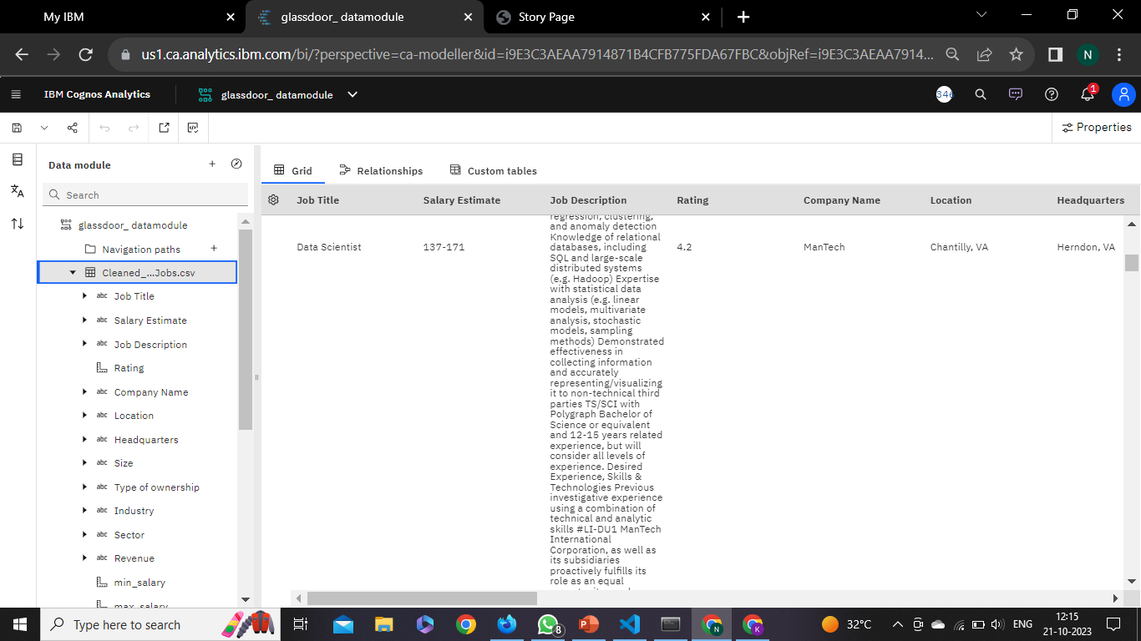
DATA SET :

Slide 3
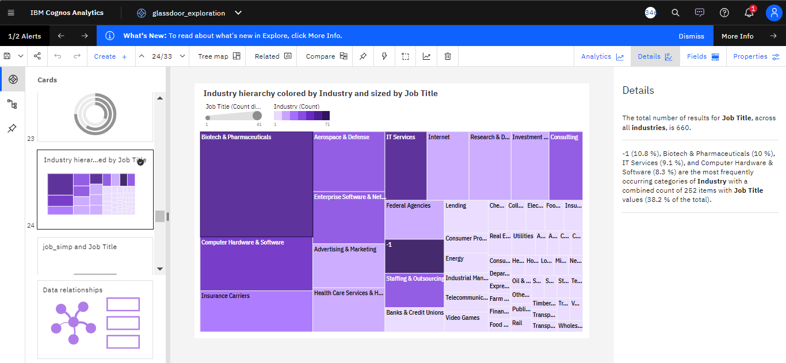
EXPLORATIONS:

Slide 4
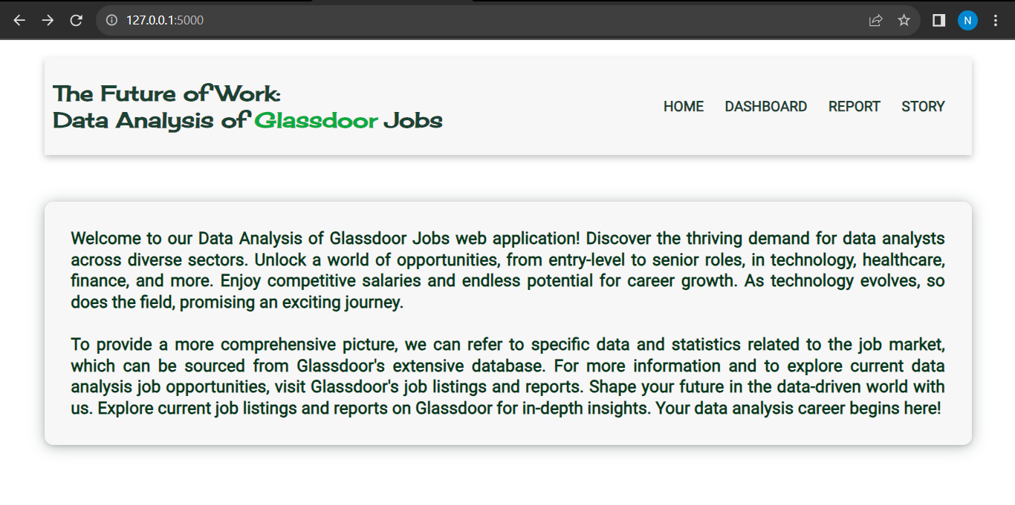
WEB PAGE:

Slide 5
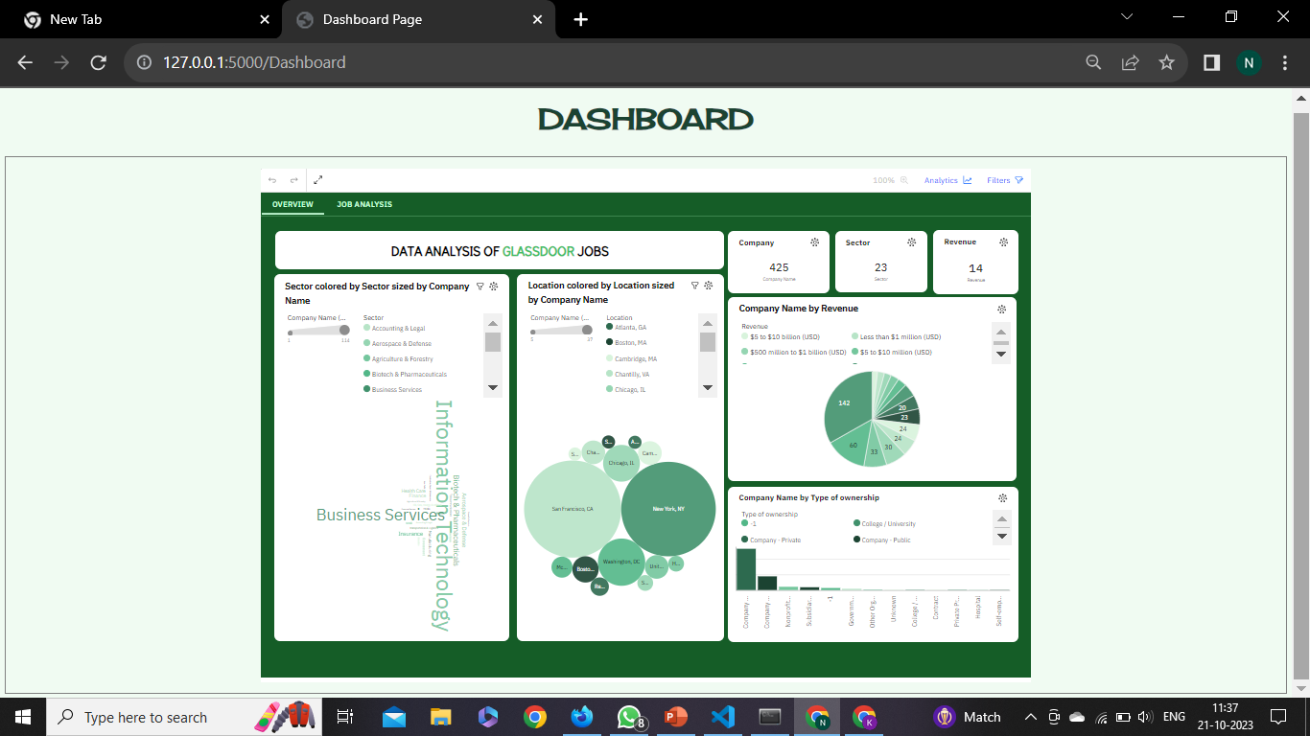

Slide 6
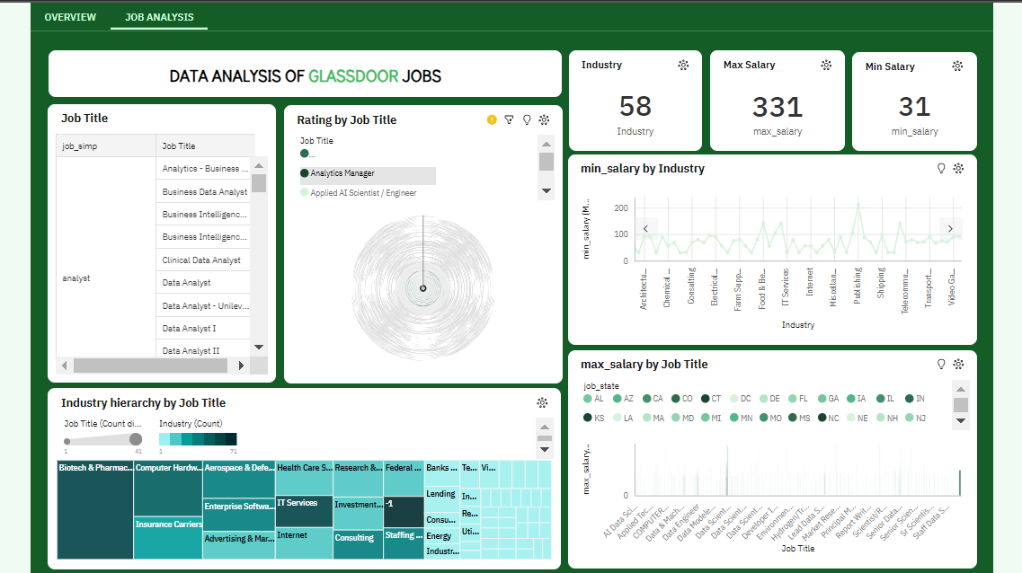

Slide 7
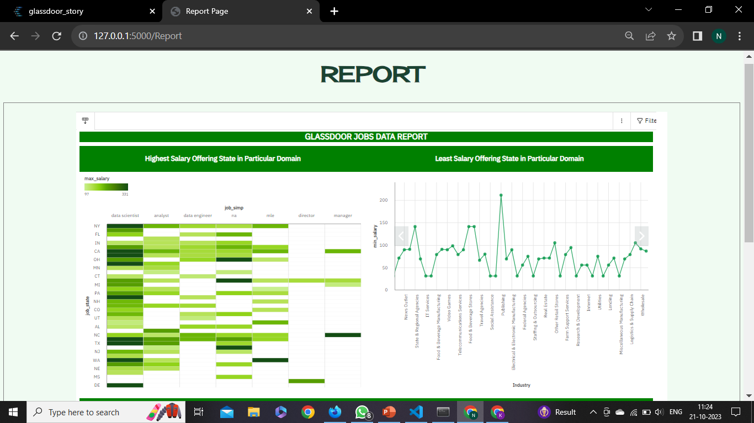

Slide 8
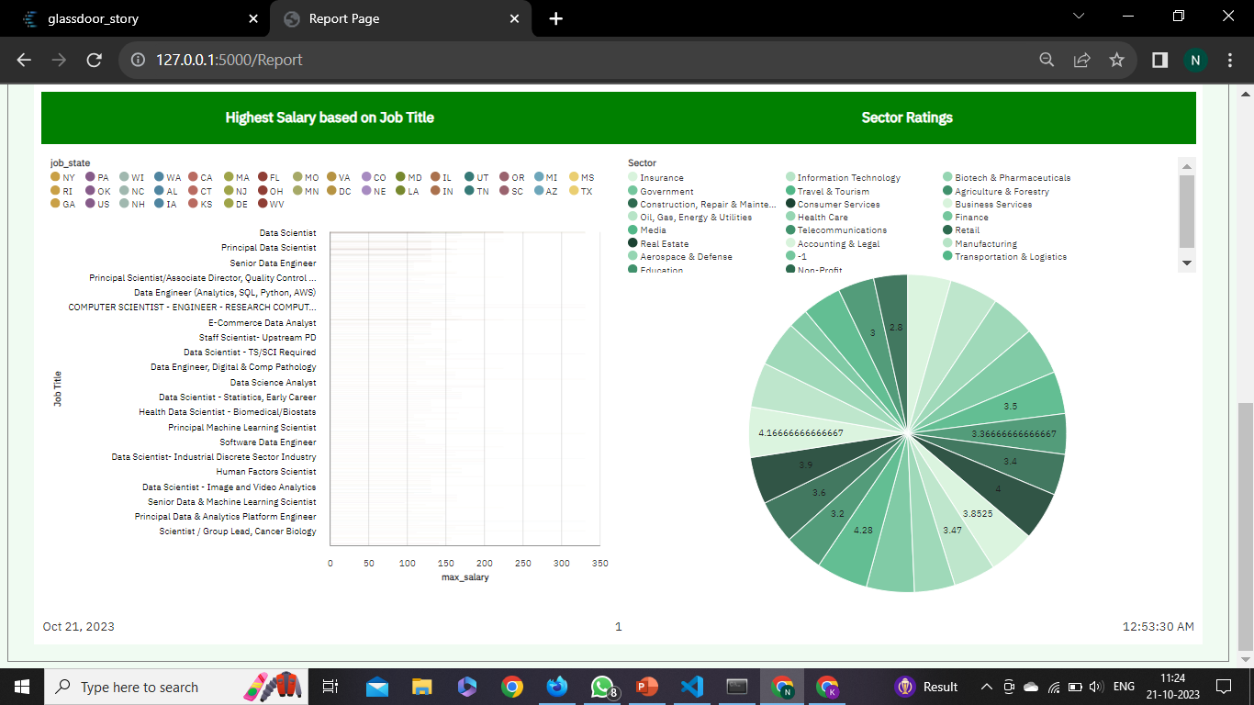

Slide 9
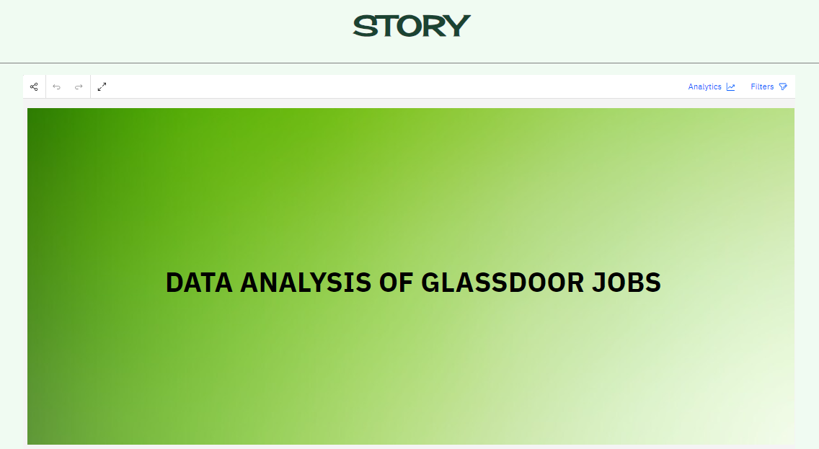

Slide 10
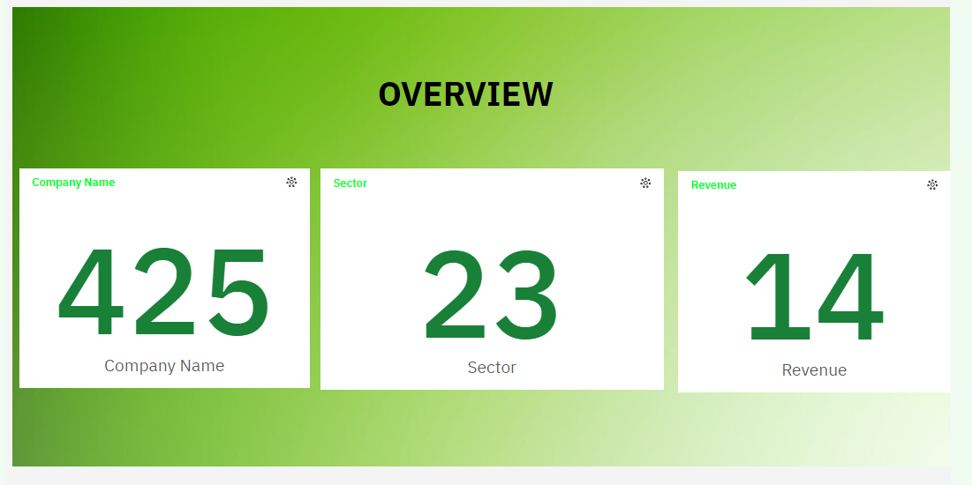

Slide 11
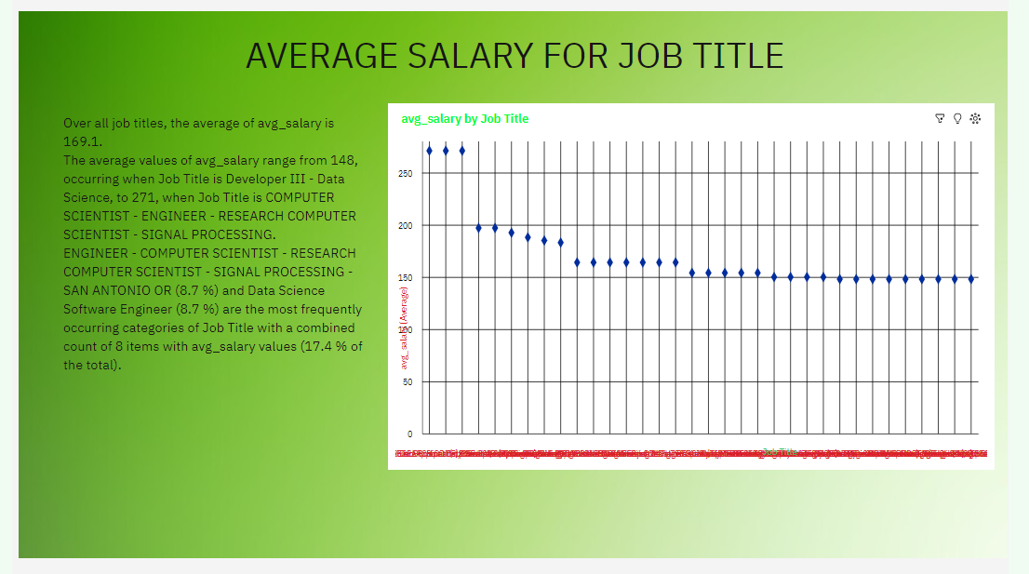

Slide 12
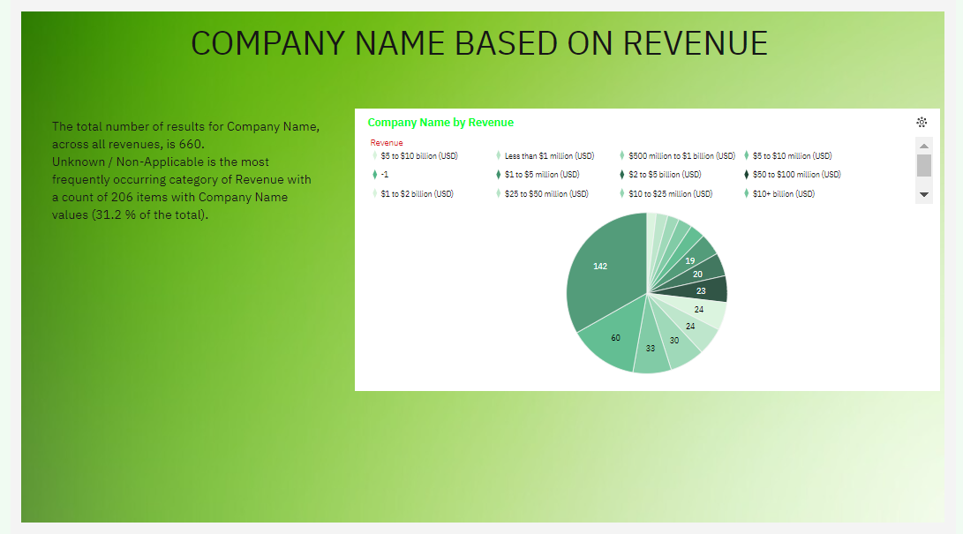

Slide 13
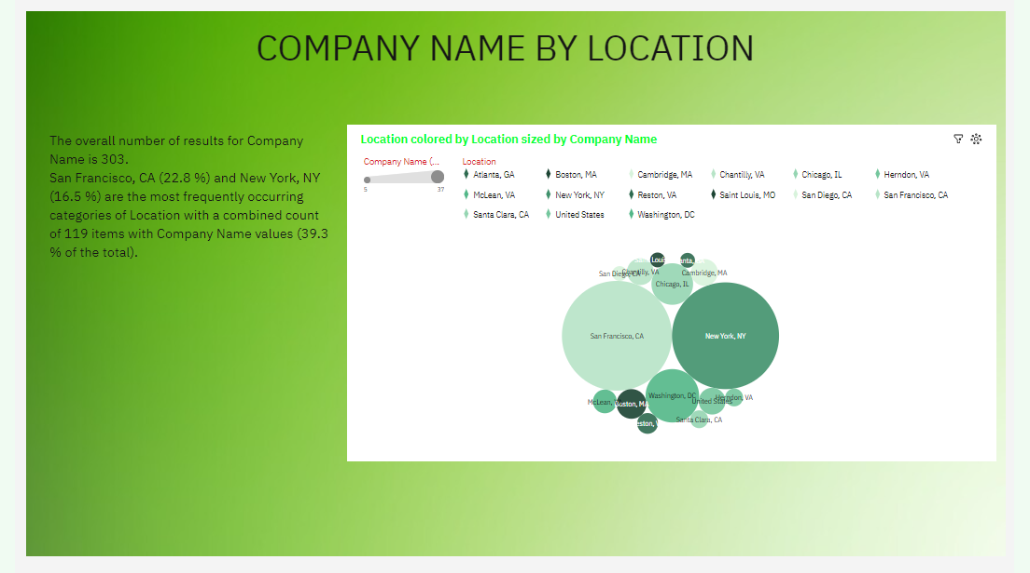

Slide 14
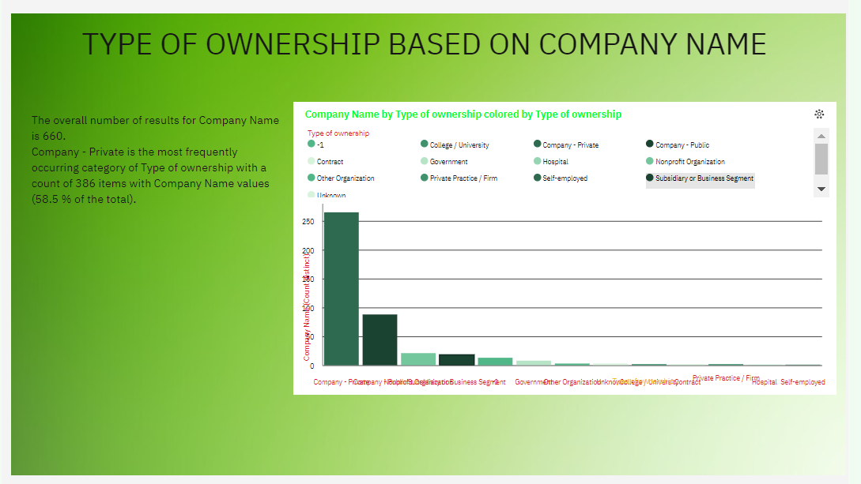

Slide 15
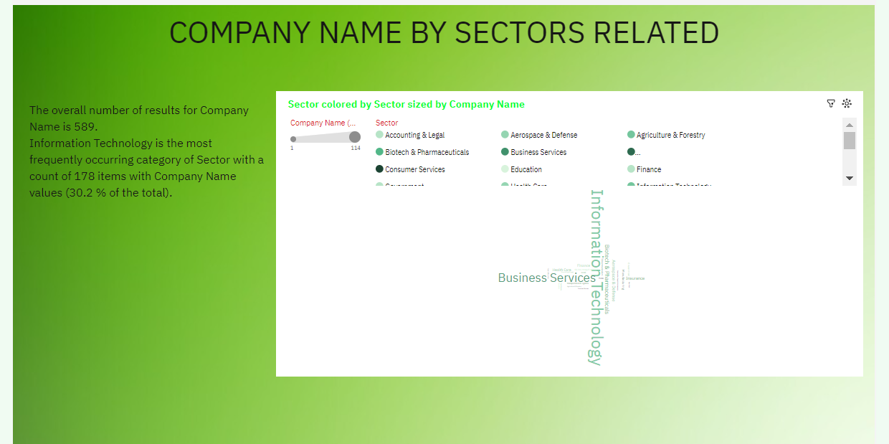

Slide 16
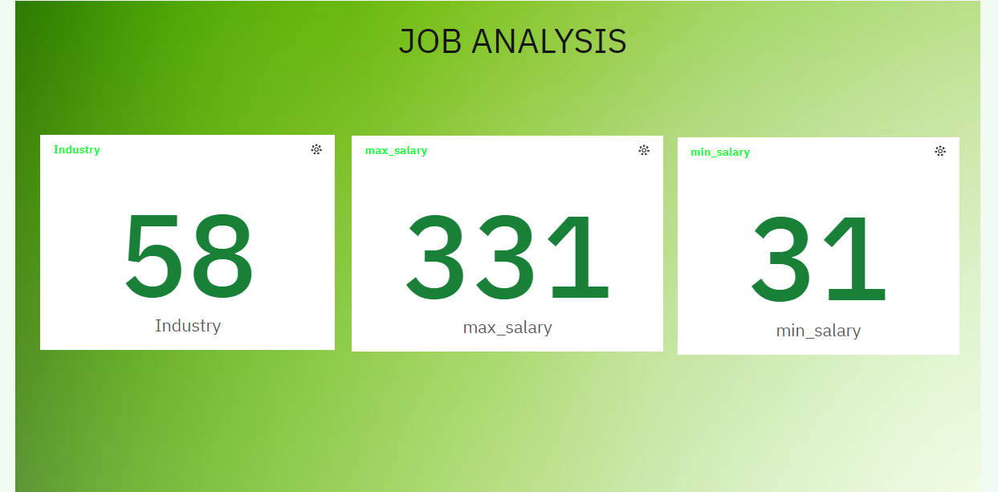

Slide 17
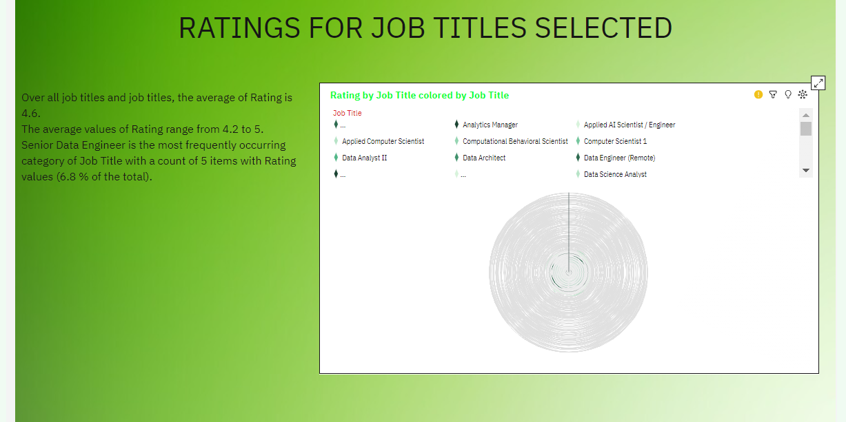

Slide 18
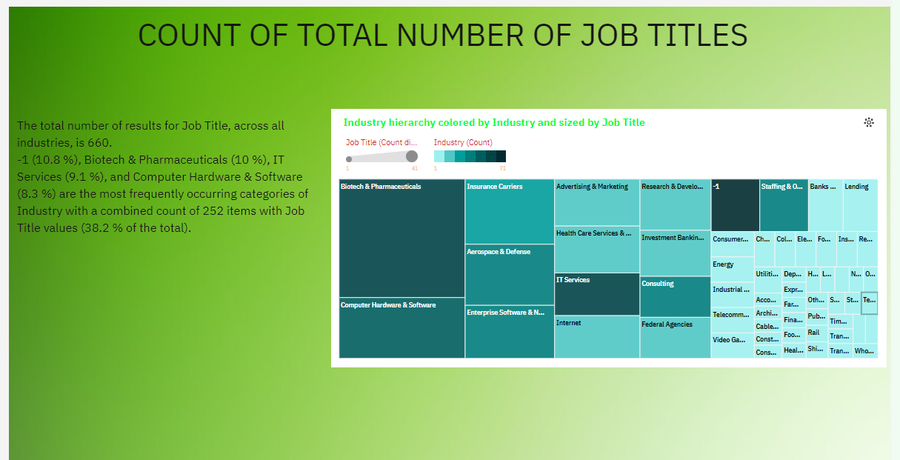

Slide 19
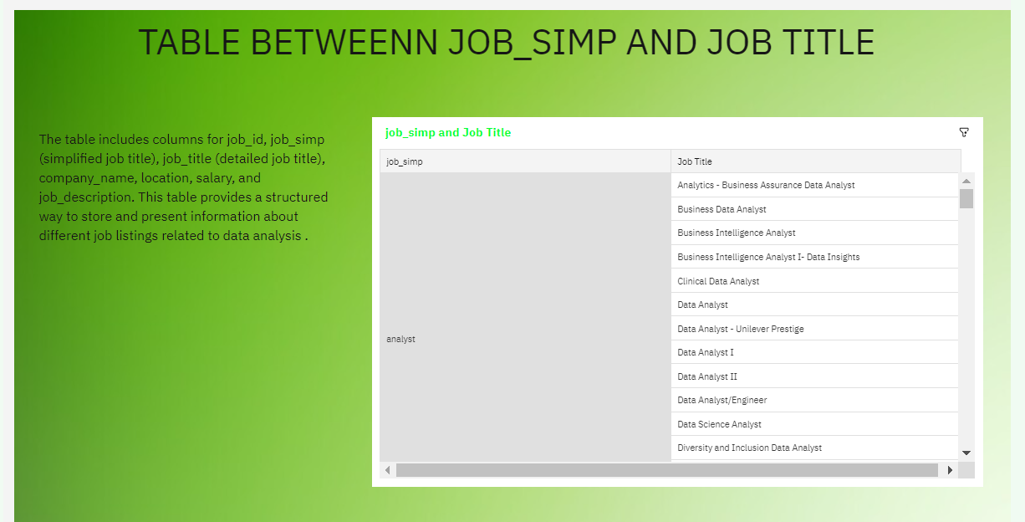

Slide 20
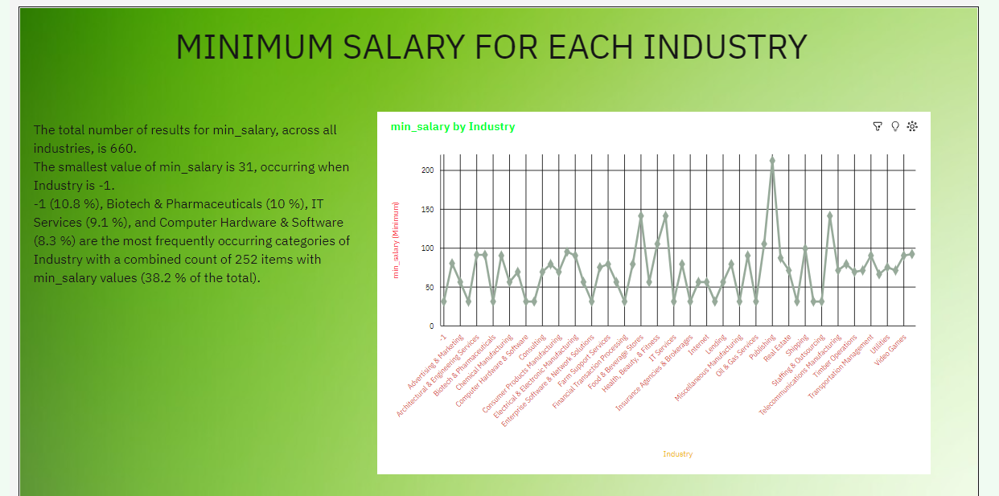

Slide 21
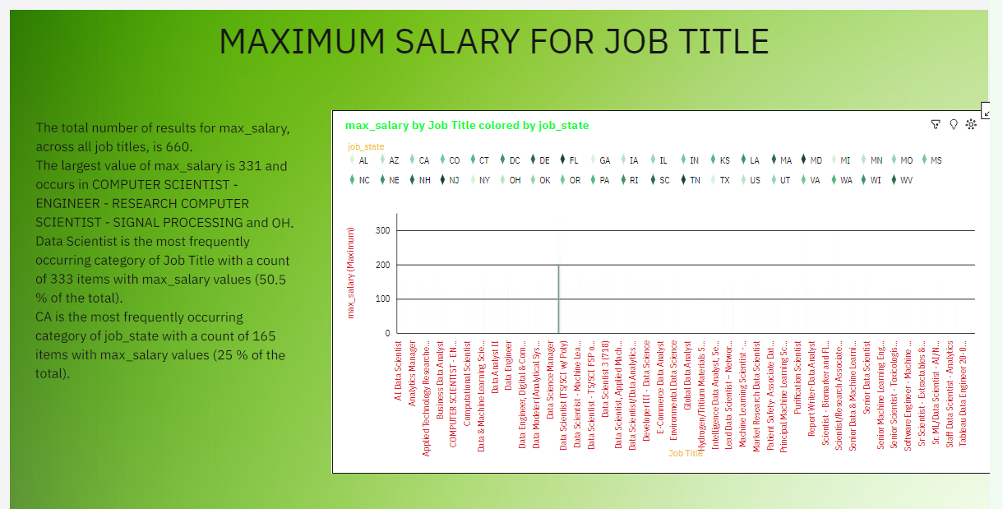

Slide 22
Thank You...

